Slide 1
ECE901 / CS838
Last Lecture
Large-scale Machine Learning
and Optimization

Slide 2
ECE901
Dimitris Papailiopoulos
University of Wisconsin-Madison
Open Challenges in Large-Scale ML

Slide 3
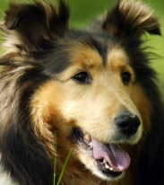






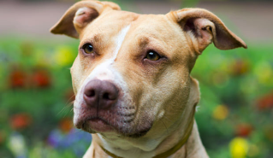
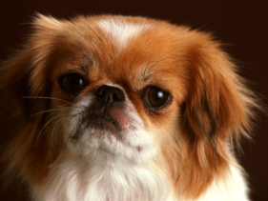

The ML pipeline
Test (unseen) Data
Input Data
Training
Model
predicted
label:
“dog”

Slide 4
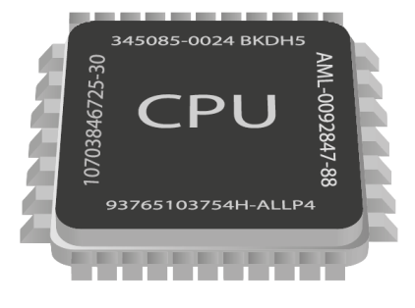
Bottlenecks in Training
Issue:
Might have millions of examples
Training on ImageNet takes 10+ days
[DawnBench, 2017]

Slide 5
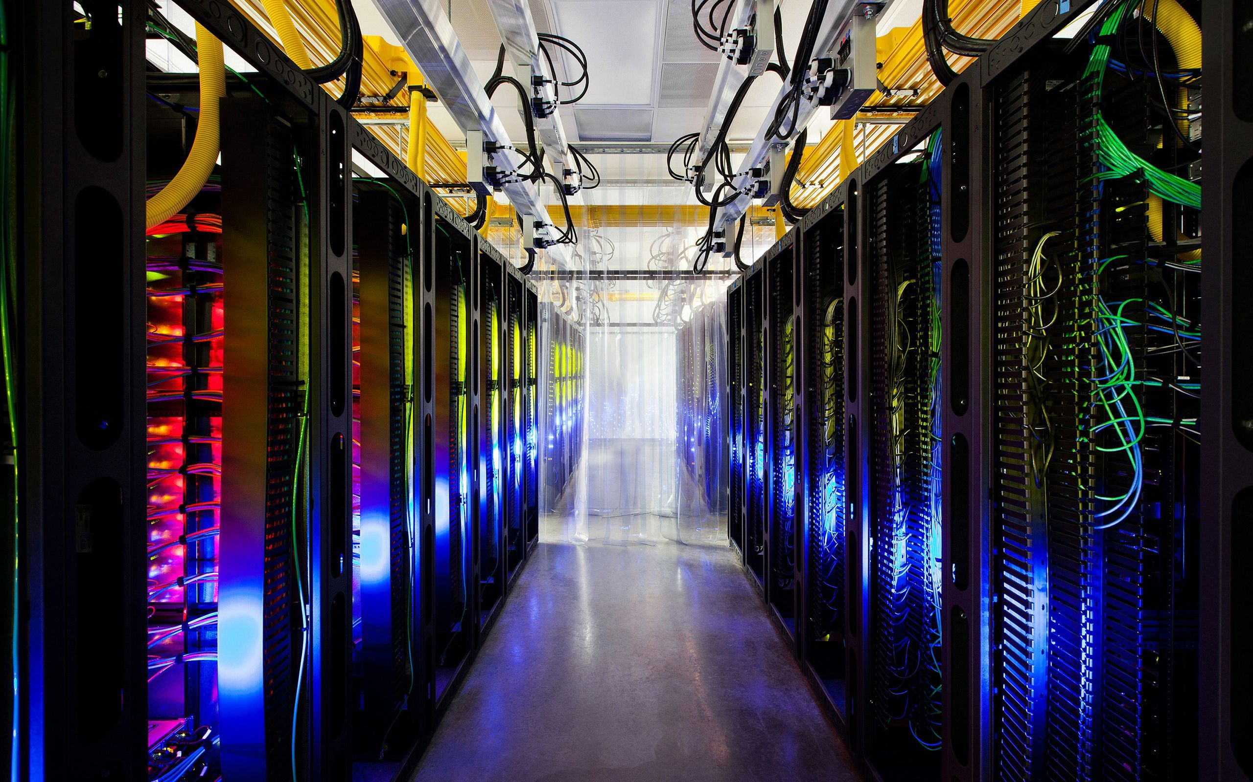
Train at scale

Slide 6
Single Machine Multicore

Slide 7
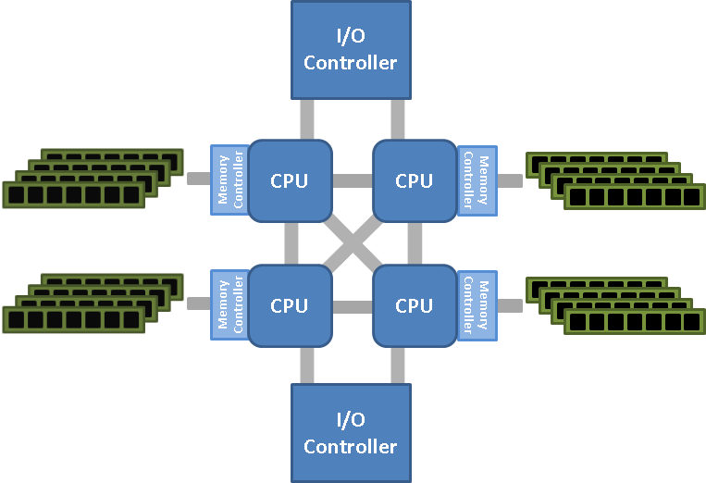
Single Machine, Multi-core

Slide 8
A case against Synchronization
overheads
timeline
CPU 1
CPU 2
CPU 3
stragglers
Asynchronous World
CPU 1
CPU 2
Faster
CPU 3
Easier to Implement

Slide 9

Challenges in Hogwild!
Shared Memory
Processor 1
Issues:
- updates can be old
results can overwritten
Speedup saturation
no “reproducibility”
Convergence analysis is tough
Processor 2
Processor P
Beyond Hogwild?

Slide 10
Sample Batch + Connected Components
Phase 1
sample
C.C.
Allocation
Phase 1I
Core1
Core 2
Core p
Asynchronous and Lock-free Stochastic Updates
Phase III
SU
SU
SU
Core1
Core 2
Core p
Wait for Everyone to Finish

Slide 11
Open Problems
Assumptions:
Sparsity is Key
O.P. :
Can Cyclades handle Dense Data?
maybe…
Run HW updates on Dense and CYCLADES on sparse?
O.P. :
Data sparsification
for f(<a,x>) problems?
Cyclades beyond Sparsity?

Slide 12
Open Problems
Hogwild! Algorithms great for Shared Memory Systems
Issues when scaling across nodes, due to comm
Similar Issues for Distributed:
speedup
#threads
O.P. :
How to provably scale on NUMA?
O.P. :
Comparison between Cyclades and minibatch
O.P. :
Sync vs Async is still open

Slide 13
Distributed Setups: Communication Bottlenecks

Slide 14
Stores the model
Gradient Computations

Slide 15
Reality ~100x worse than optimal
Optimal Speed-up
WHY?
“Large Scale Distributed Deep Networks” [Dean et al., NIPS 2012]

Slide 16
Two factors control run-time
Time to accuracy ε =
[time per data pass] X [#passes to accuracy ε]

Slide 17
systems perspective: large batch is better
Statistical perspective: small batch is better.
Main Question:
Are big batches fundamentally bad?
If batch size is beyond a threshold => worse accuracy

Slide 18
Big batches beget redundancy
“similar” workload
Workers compute identical gradients => useless! no speedup
Thm:
Problems with high “workload diversity”
More amenable to parallelization.

Slide 19

Open Question: How to increase Diversity?
We want to maximize
Possible ways:
Data pre-processing (similar to preconditioning)
Dropout (e.g., gradient sparsification)
Design deep architectures that suppress interference

Slide 20
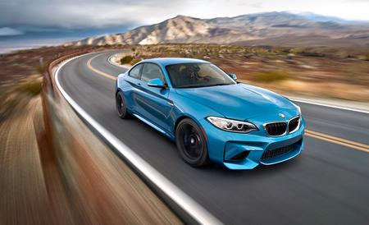
Open Question: How to Beat Interference?
We want to maximize
Possible ways:
Data pre-processing (similar to preconditioning)
Dropout (e.g., gradient sparsification)
Design deep architectures that suppress interference

Slide 21
Conclusions
A better algorithm?
Novel analysis of minibatch SGD based on gradient interference
Batch size cannot increase beyond a fundamental point
Tight lower bound
Open Problems:
Lower bound for generalization
Fundamental trade-off between parallelizability and statistical accuracy
Stragglers

Slide 22
A better algorithm?
Communication / worker:
O(size of gradient)*32 bits
Q: Lower precision?
O(size of gradient)*4 bits
A: Yes!
A lot of recent work on quantized SGD

Slide 24
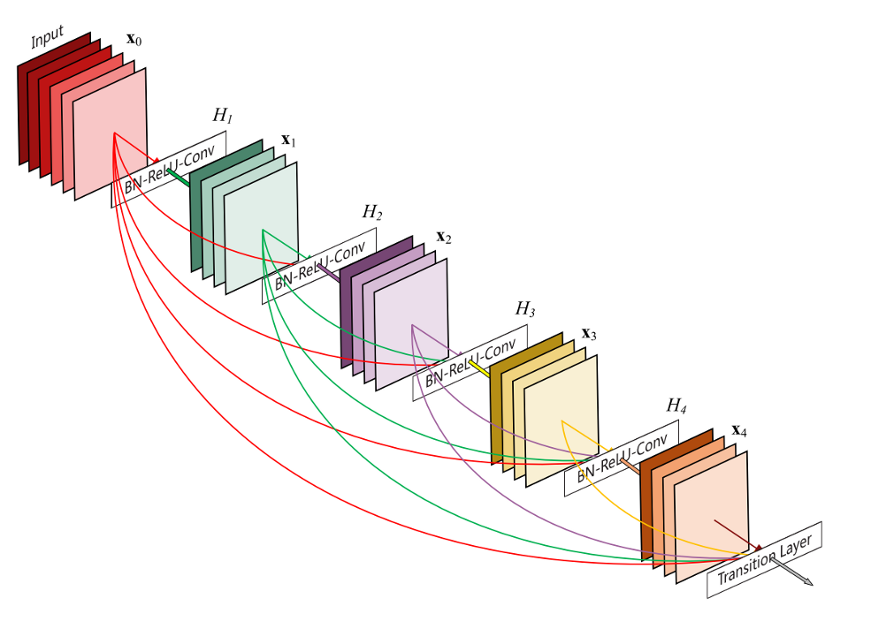
Geometry-preserving Q-SGD?
Each layer a different matrix
Each matrix has local geometry
32->4 bit quantization does not respect it

Slide 25
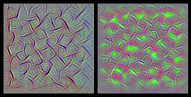
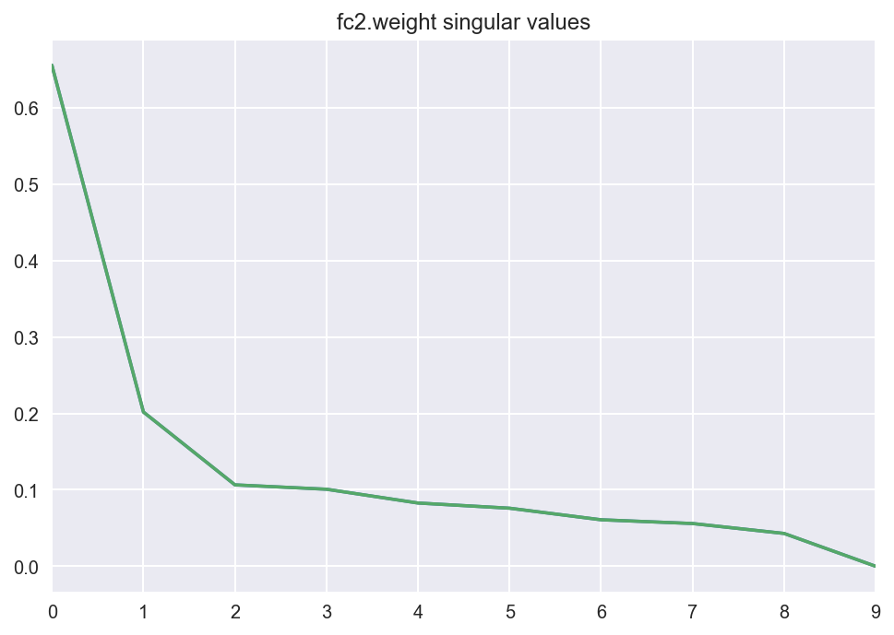
Spectrum of Gradients
Observation: Fast decaying spectral profile (SVD)
What if we quantize in the spectral domain?

Slide 26
Systematic Recipe
Open Problem:
What is the min. variance
StochGrad that is succinct

Slide 27
Open Problems
Optimal Compression for Gradients?
Small batch vs Large batch Training?
Is GD actually worse than SGD?
Second order training (approx hessian)?
Data Shuffling, and data moving
Heterogeneous setup?

Slide 28
Stragglers

Slide 29
“The scale and complexity of modern Web services make it infeasible to eliminate all latency variability.”
Dean and Baroso, 2013
Notes:
Large-scale computing systems have 3 main layers: Storage layer, Communication Layer, and Computation Layer. Data is read from the storage layer, and transmitted through the network towards the computing nodes. The new results of computation are then stored again to complete the loop. each of these steps incurs some delay and uncertainty. Can codes robustify algorithms against this system noise?

Slide 30


Bottleneck 2: Straggling Learners
model
model
model
model
model
Can we “robustify” distributed ML
against stragglers?
Measured on Amazon AWS

Slide 31
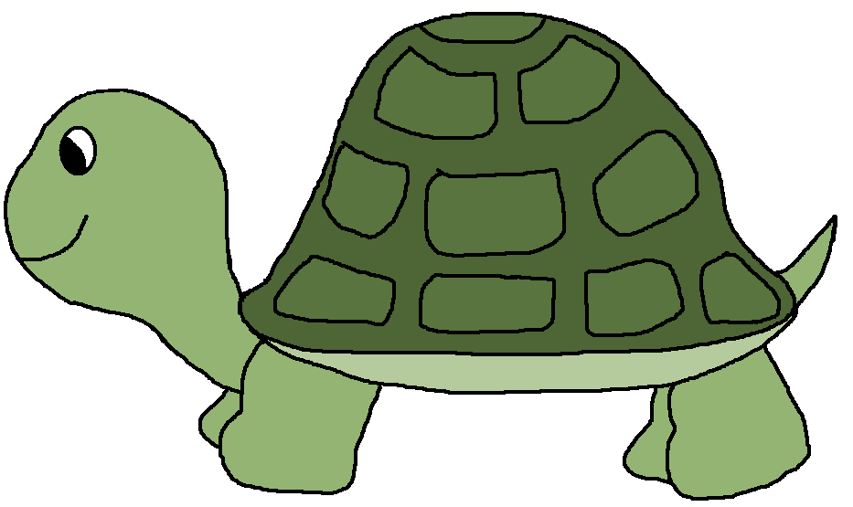
A’₁X
M
A₁
A’₁
A’₂X
A
A₂
A
W₁
W₂
W₃
A’₂
A₃
A’₁
X
A’₂
X
_{(A’1+A’2)}
X
+

Slide 32
Open Problems
Beyond linear functions?
A hybrid between async + codes
Combination of cyclades + codes?
Codes vs node termination?

Slide 33
Choices choices choices

Slide 34
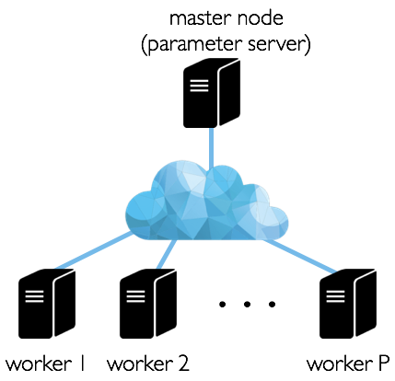
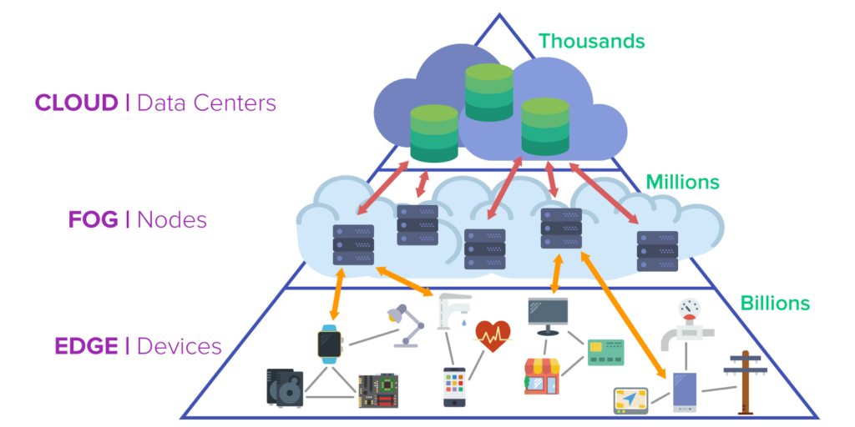
Platforms
Parallel
Single machine, multicore
Multi-socket NUMA
Distributed

Slide 35
How to choose the right model
Some models are better than others,
even from a systems perspective
Does it fit in a single machine?
Is model architecture amenable
to low communication?
Some models easier to partition
Can we increase sparsity (less comm)
without losing with accuracy?

Slide 36
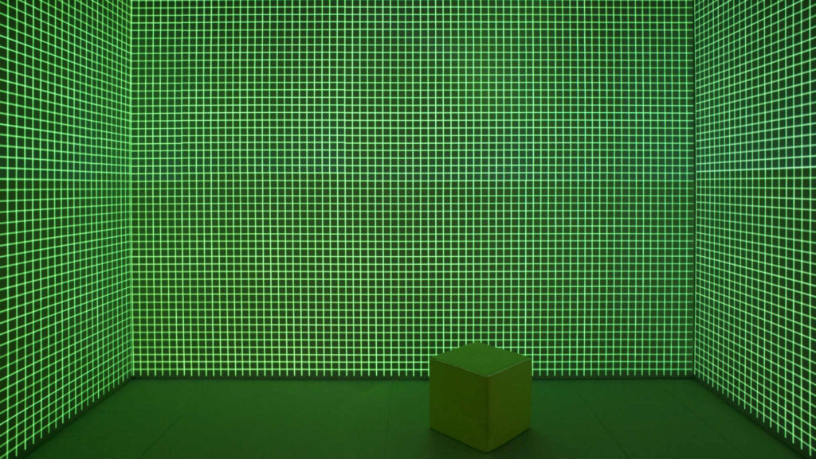
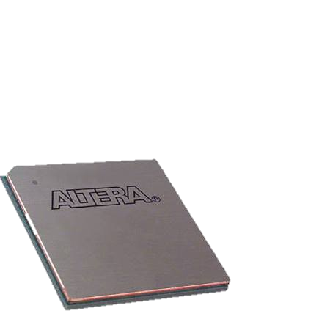
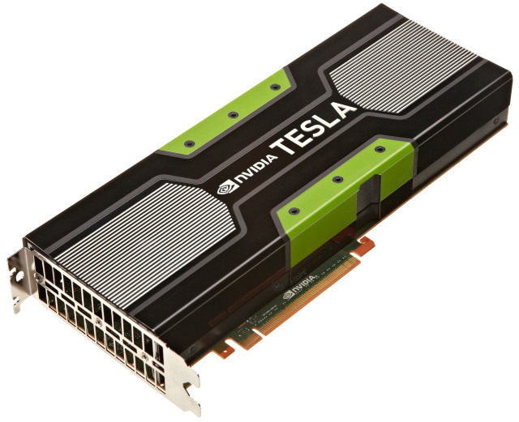
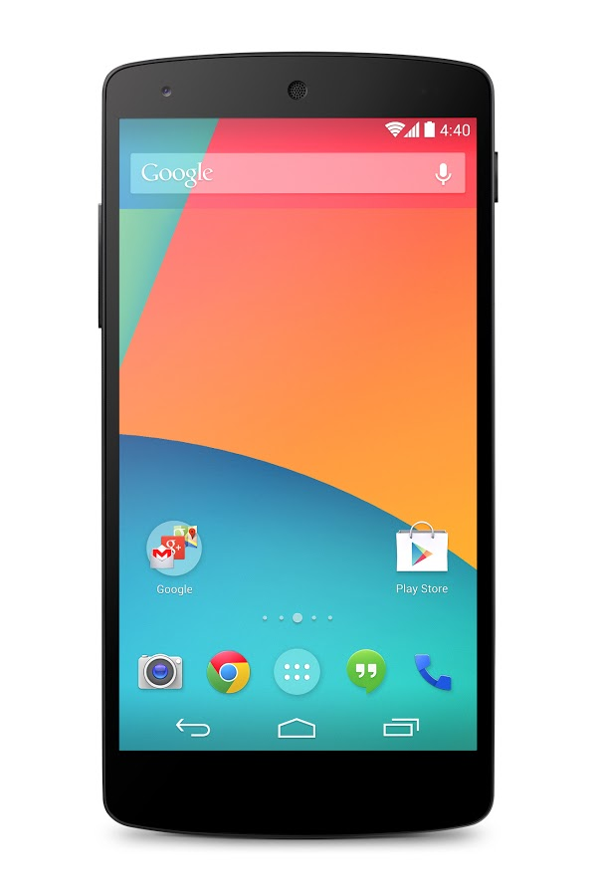
Optimal Quantization?
What is the “optimal” algorithm?
Beyond Master Worker?
Heterogeneous setup + the edge?
What is the “optimal” platform?

Slide 37
Conclusions
A long way to go
Novel analysis of minibatch SGD based on gradient interference
Batch size cannot increase beyond a fundamental point
Tight lower bound
Open Problems:
Lower bound for generalization
Fundamental trade-off between parallelizability and statistical accuracy
Stragglers

Slide 38
Model Compression

Slide 39
Size and Ops
ResNet-152 ~ 230 MB
[Canziani, Culurciello, Paszke, 2016]

Slide 40
Tradeoffs
A Good model has to:
Have high accuracy
Be easily trainable
Be fast during inference
Be compact

Slide 41
Remarks
Several interesting papers on model quantization and compression, especially for edge devices/low-power HW
Low-rank factorization
Training quantization levels
SqueezeNets/MobileNets/Ternary Nets/ShuffleNet
Which one is best?
Power considerations
Theory for pruned/quantized nets?
how many weights can I throw away before I incure an error ε?
Use of expanders?
Sparse approximation theory?
Matrix Sketching?

Slide 42
Robustness During Inference

Slide 43
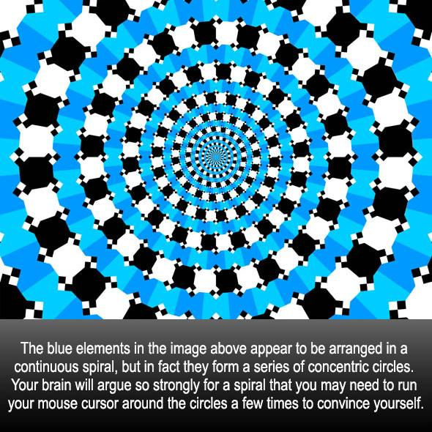

Slide 44
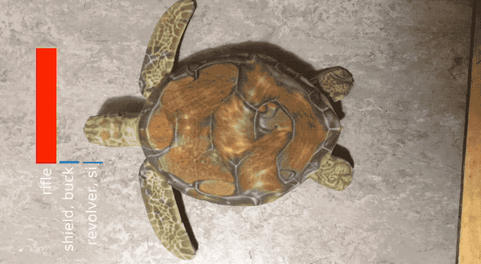
Adversarial Examples in Real Time

Slide 45
Robustness of Classification
Robustness:
“The predictions are insensitive to small input perturbations”
Predict(model, ) ≈ Predict(model, )
NNs are not robust against adversarial examples

Slide 46
Defense??
Can we design defense mechanisms??
Defense
Predict(x)
Input
Output

Slide 47
Strongest Defense: Adversarial Training
~50% accuracy

Slide 48
Open Problems
No universally good defense
Adversarial training is slow
Provable (even slow) defenses?
Are Robustness and Learning incompatible?
Are Robustness and poly-number of samples incompatible?
Use of Coding for Defense???

Slide 49
Robustness During Training

Slide 50
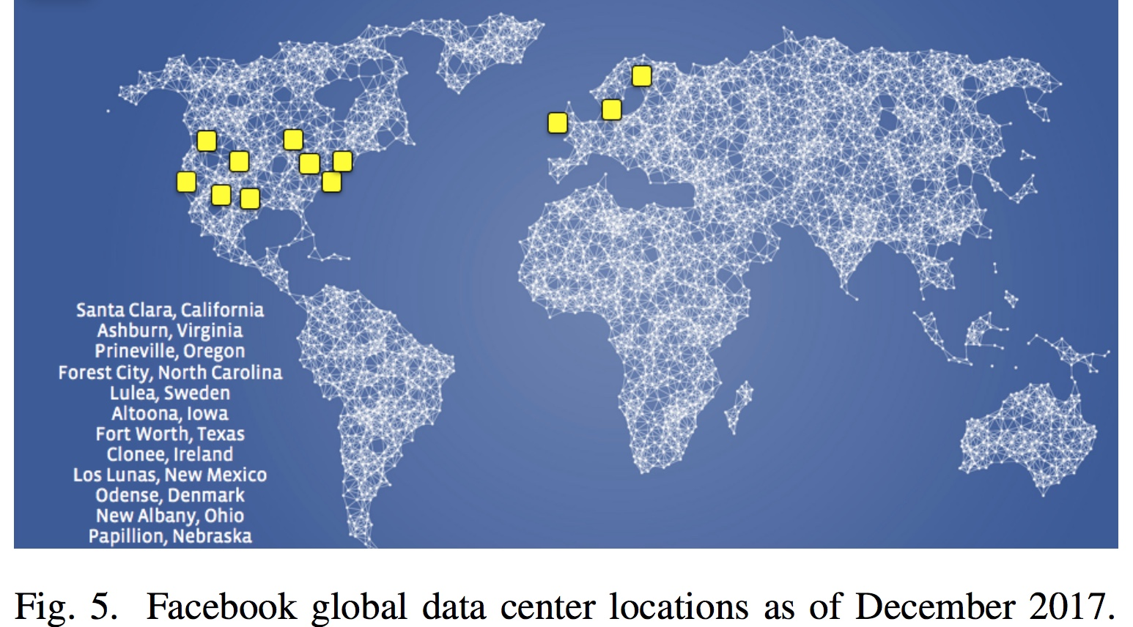
Robustness: a key Challenge
“For […] training and inference […] the importance of disaster-readiness cannot be underestimated.”
“Adversaries are constantly searching for new […] ways to bypass our identifiers […]”
Applied Machine Learning at Facebook: A Datacenter Infrastructure Perspective [fb, HPCA2018]

Slide 51
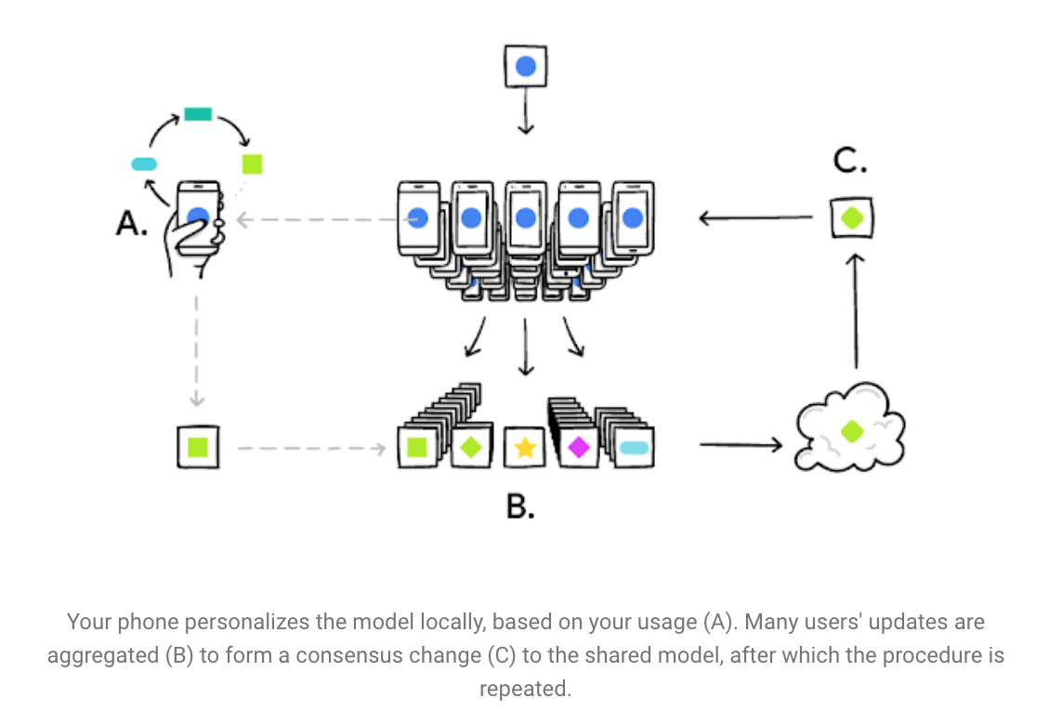
Robustness: a key Challenge
What if Adversarial?

Slide 52
minibatch SGD is not Robust
Lemma:
A single adversary can arbitrarily corrupt the model, even if it’s sending the “correct” direction update.

Slide 53
Can we Robustify SGD?
Robust Mean?
[Blanchard, El Mhamdi, Guerraoui, Stainer 2017]
[Chen, Su, Xu, 2017]
[Yang, Bajwa, 2017]
[Xie, Koyejo, Gupta, 2018]
[Yin, Chen, Ramchandran, Bartlett, 2018]
[Alistarh, Allen-Zhu, Li, 2018]

Slide 54
Can we Robustify SGD?
can be very robust… but
“nearly” linear in theory [CLMPS16]
but expensive in practice
Convergence theory requires
many assumptions
Model not reproducible

Slide 55
Open Problems
Fundamental Trade-off?
Robustness vs computation
Robust mean vs Error Correcting Codes
Privacy + Computation Redundancy

Slide 56
Federated Learning

Slide 57
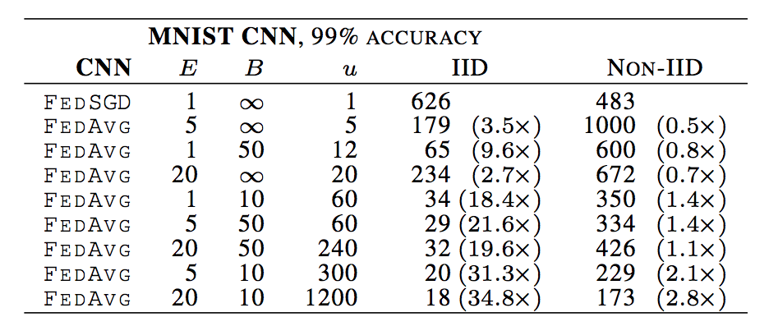
Impact of Private Shuffling
Shuffling would allow faster convergence (10x)
[McMahan, Moore, Ramage, Hampson, Aguera y Arcas, 2016]

Slide 58
Open Challenge: Privacy
Can we enable private data shuffling??

Slide 59
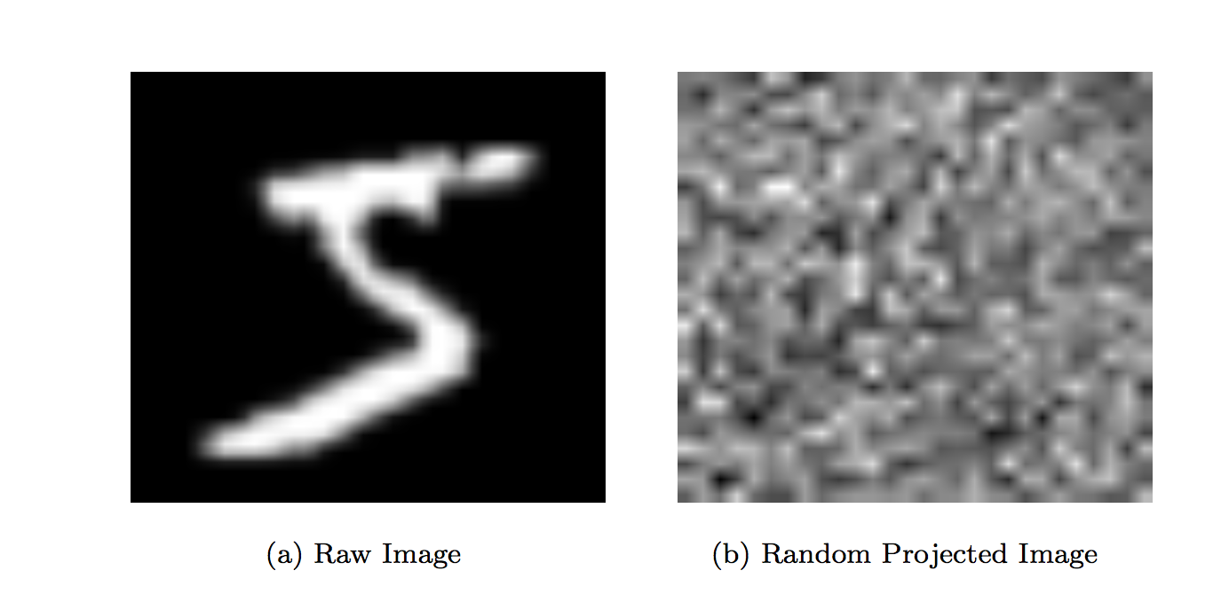
Private Data Shuffling ?

Slide 60
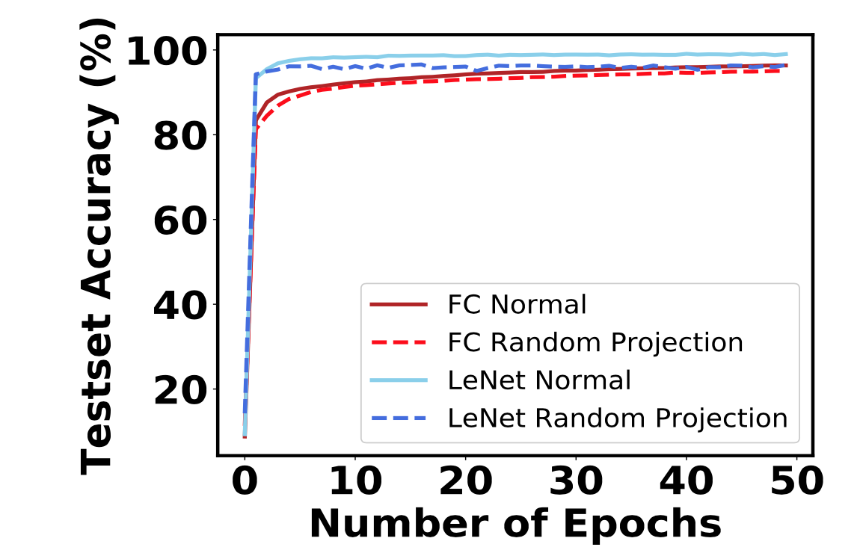
Private Data Shuffling ?
Provable Privacy?
Tradeoff between “learnability” and privacy

Slide 61
Open Problems
Fed. learning + non-iid samples = bad convergence
Shuffling can help, but 1) it costs 2) it’s not private
Can we enable private shuffling?
Can we build algorithms that don’t need shuffling?
Comm. costs and power issues during Fed. Learning
Privacy issue: Model Leaking Information about data?

Slide 62
Model Generalization

Slide 63
Generalization: The goal of ML
Given: n examples i.i.d. from
Goal: Train a model that predicts well on unseen (ie., test) data.
True Risk (test error)
Empirical Risk (train error)
(Model w trained by iterative learning algorithm)
Generalization gap:

Slide 64
Traditional Learning Theory
VC-dimension like bounds, TL;DR:
If your model has “complexity” d, then you need
O( d /ε^2 ) samples for ε generalization gap

Slide 65
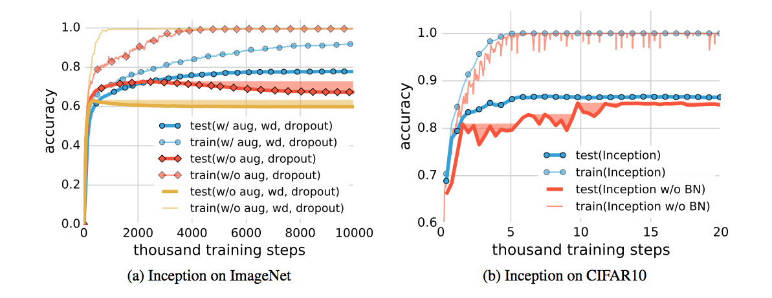
What gives rise to generalization?
Understanding deep learning requires rethinking generalization
Chiyuan Zhang, Samy Bengio, Moritz Hardt, Benjamin Recht, Oriol Vinyals
ICLR 2017, Best Paper Award
VC bounds can’t explain that, oblivious to the algorithm
What allows SGD to generalize so well?

Slide 66
Algorithmic Stability
An algorithm A(S) is “stable” if:
“the model does not depend too much on one data point”
Let = original data set, but without the i-th data point
Def: Pointwise hypothesis stability
Thm: (Bousquet and Elisseeff 2002)
-stable algorithms achieve generalization gap

Slide 67
Open Problems
What algorithms are Stable?
Connections between Stability and Information theory
Stability via sample hessian sharpness @ local minimizers
Connections to robustness against adverserial attacks
GD vs SGD: is there a dichotomy?
Testing stability in sublinear time
Why do SGD trained neural nets generalize so well?

Slide 68
Fairness

Slide 69
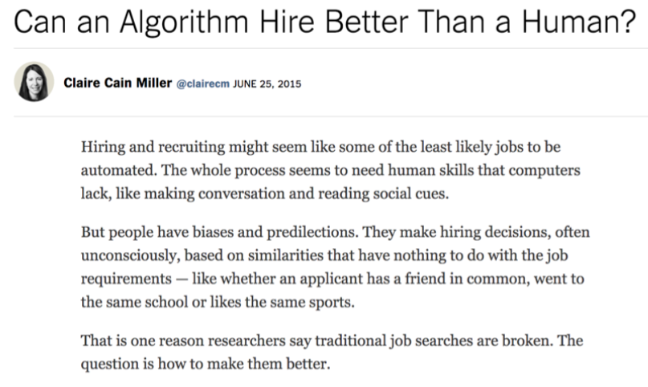
[Moritz Hardt, tutorial on fairness, NIPS 2017

Slide 70
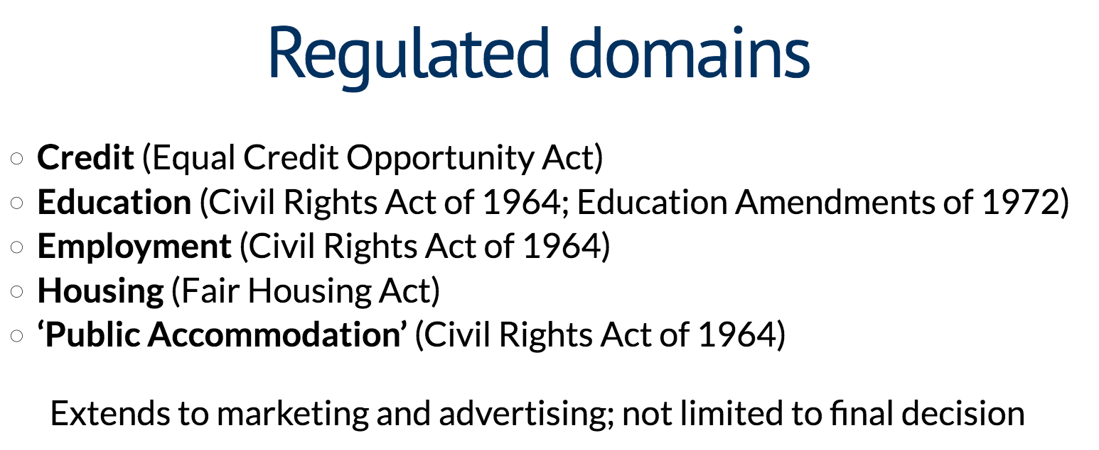
[Moritz Hardt, tutorial on fairness, NIPS 2017

Slide 71
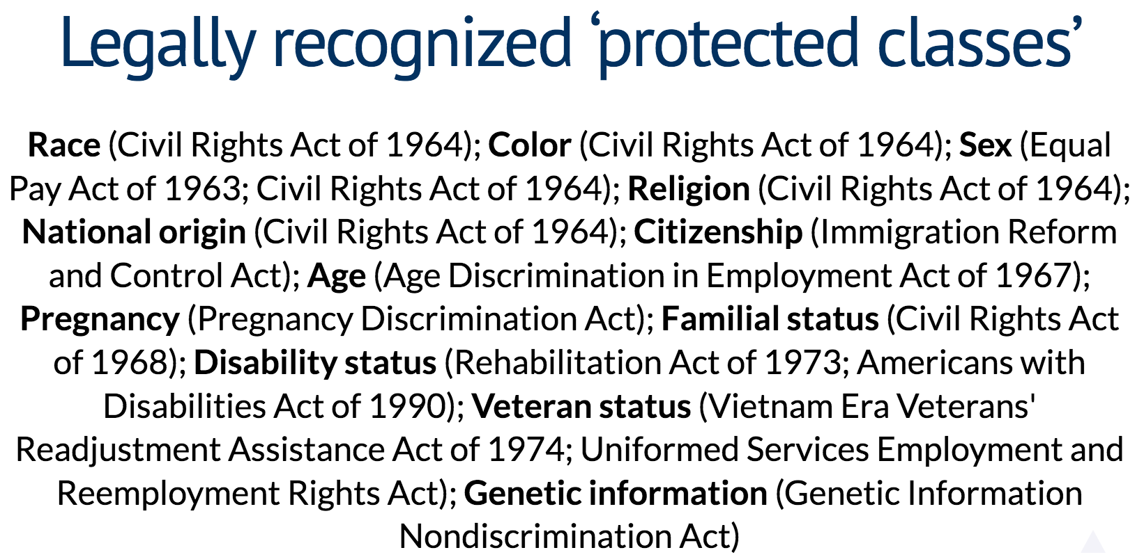
[Moritz Hardt, tutorial on fairness, NIPS 2017

Slide 72
Open Problems
How to define fairness?
How to enable models that don’t discriminate?
Fairness in Distributed/Federated Learning?
How is it for an adversary to poison the data and make a classifier biased?
Fairness and Differential Privacy?

Slide 73
Distributed vs Parallel?
Gradient Quantization
Communication Bottlenecks
Stragglers
Heterogeneous systems
Model Quantization
Privacy
Fairness
Robust Training
Federated Learning

Slide 74
The goal:
Enable Fast, Robust, Interpretable, Fair
Distributed Learning

Slide 75

You want to be here!
Algorithms / Optimization
Statistics /
Information Theory
Systems

Slide 76
I hope you had fun

Slide 77

fin

